Slide 1
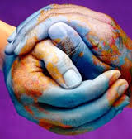
Around the World – Diversity
Notes:
Welcome Intros
"Love and compassion are necessities , not luxuries. Without them humanity cannot survive."

Slide 2
Agenda
Guidelines
Activity – What I want you to know
Terminology
Tips – How to be an advocate
Questions & answers

Slide 3
Guidelines
What is learn in this session leaves; what is said in this session stays here.
Use "I" Statements
Criticize ideas, not individuals
Assume Best Intentions
Step In & Step Out

Slide 4
What I Want You to Know About Me – Activity
This activity will give you the chance to introduce yourself to the group in your own words, and will help you relate to one another more easily as we begin our time together.

Slide 5
What I think about me ...

Slide 6
What others think about me ...

Slide 7
What might be misunderstood about me ...

Slide 8
What I need from you ...

Slide 9
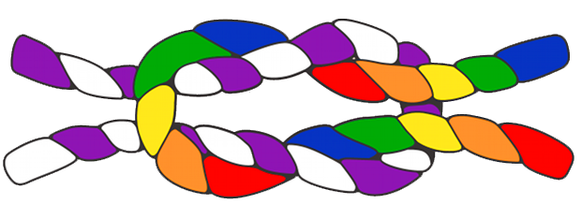
Debrief

Slide 10
Terminology
PRIVILEGE: Privilege operates on personal, interpersonal, cultural, and institutional levels and gives advantages, favors, and benefits to members of dominant groups at the expense of members of target groups.

Slide 11
Terminology
OPPRESSION: The combination of prejudice and institutional power which creates a system that discriminates against some groups (often called “target groups”) and benefits other groups (often called “dominant groups”).
These systems enable dominant groups to exert control over target groups by limiting their rights, freedom, and access to basic resources such as health care, education, employment, and housing.

Slide 12
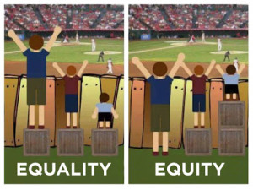
Terminology
Equity, as we have seen, involves trying to understand and give people what they need to enjoy full, healthy lives. Equality, in contrast, aims to ensure that everyone gets the same things in order to enjoy full, healthy lives. Like equity, equality aims to promote fairness and justice, but it can only work if everyone starts from the same place and needs the same things.

Slide 13
Activity - Concentric Circles
The Concentric Circles allow participants to explore their feelings and experiences about societal issues and to explore their cultural identity and how it relates to others.
It can be difficult getting to know someone new because we don't always ask the right questions or we take a long time to get to the point. In this activity, we will pose questions to you and your partners that will require you to share information very quickly.

Slide 14
-What is your full name? - How did you get that name? -What does it mean to you?

Slide 15
- What is your race and/or ethnicity? - What does it mean for you to be that race/ethnicity?

Slide 16
Listen for more questions.

Slide 17
Debrief
Notes:
Which questions were easy to answer? More difficult?
What surprised you the most about how you answered the questions?
Did you answer honestly? If not, why? If you did what allowed you to disclose?

Slide 18
15 MINUTES

Slide 19
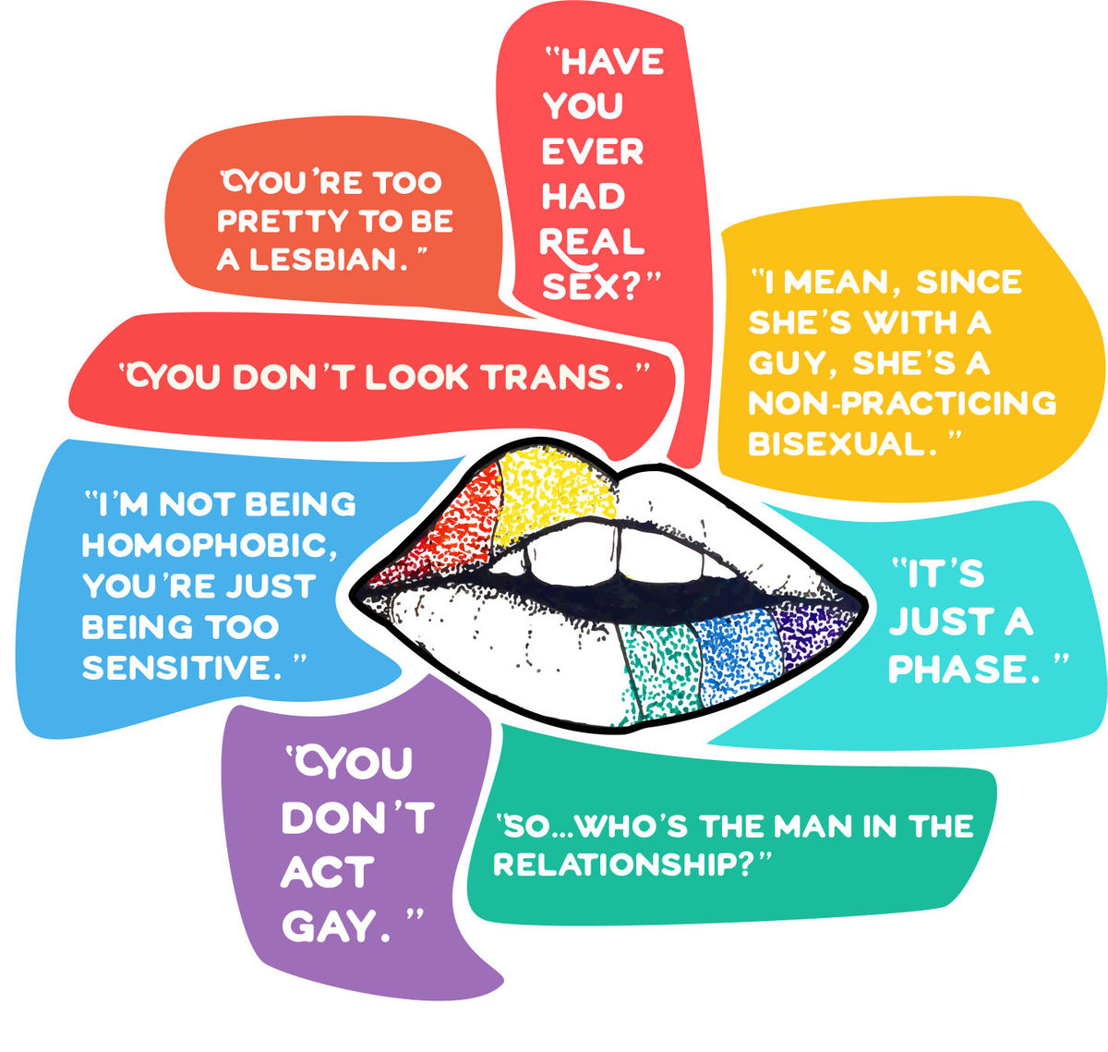
Microaggressions & Bias

Slide 20
Terminology
Microaggressions: A subtle but offensive comment or action directed at a minority or other nondominant group that is often unintentional or unconsciously reinforces a stereotype:
- "I don't see you as black.".
- "No, where are you really from?"
- "You don't speak Spanish?"
- "No, you're white"

Slide 21
Terminology
Unconscious Bias: Also known as implicit bias, unconscious bias refers to our attitudes, perceptions and stereotypes that influence our understanding, actions, and behavior when interacting with various identities. These preferences, which can be for or against groups, are developed through an exposure to stereotypes and misinformation informed by our upbringing and life experiences. Residing deep in the subconscious, these biases are different from known biases that individuals may choose to conceal for the purposes of social and/or political correctness.

Slide 22
Verbal Frisbees
This activity will allow participants to confront some of the most common resistance-quotes. The group will brainstorm ways in which to react to them.

Slide 23
Group 1
● A mother visiting during Family Weekend takes a bottle of Febreeze and sprays it in the direction of her daughter's roommate. The target of the Febreeze is a Latina woman. The mother says, “No offense. You just smell a little funny, that's all.”

Slide 24
Group 2
● An African American student is walking behind a group of white students. The student hears the group in front of her telling racially motivated jokes. One of the students turns around and says, “A black girl is behind us.” Another responds, “Like I give a shit,” and laughs loudly.

Slide 25
Group 3
● A student worker in the Intercultural Resource Center hears male voices say, “The diversity office? White pride, dude! White pride!”

Slide 26
Group 4
● A student posts the following message on the student listserv: “As a Catholic institution, we should uphold the belief that homosexuality is a sin. Join me tomorrow as we protest the use of our funds to have LGBT programming at Stonehill.”

Slide 27
Group 5
● A student posts the following message on the student listserv: “As a Catholic institution, we should uphold the belief that homosexuality is a sin. Join me tomorrow as we protest the use of our funds to have LGBT programming at Stonehill.”

Slide 28
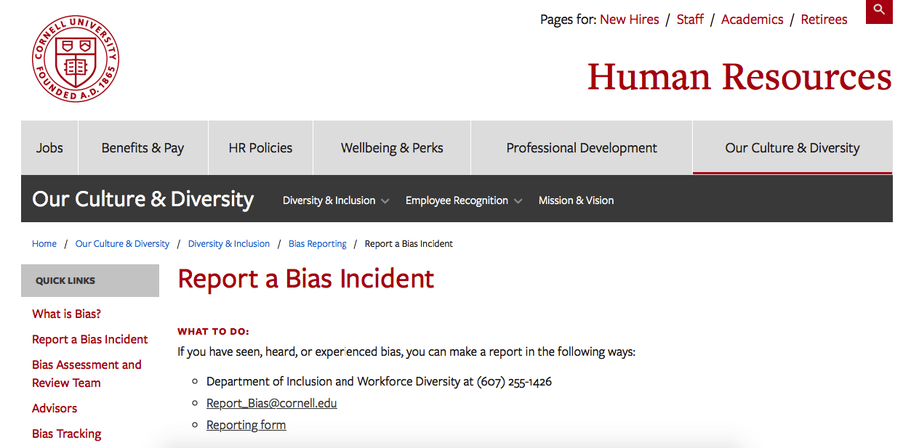
Reporting
https://hr.cornell.edu/our-culture-diversity
Notes:
Is this for emergency cases?NO!
Your e-mail.

Slide 29
Advocate
Learning
Skill Building
Action
Going to events
Knowing how to check your own privilege
Practice
Identify unjust systems and behaviors
Being present for someone
Reporting
Educating
Allowing yourself to fail and learn

Slide 30
Notes:
What are the three most important points you learned today?
What important questions remain unanswered for you?
What did you learn specifically from what someone else said that you would not have thought of on your own?

